Slide 1

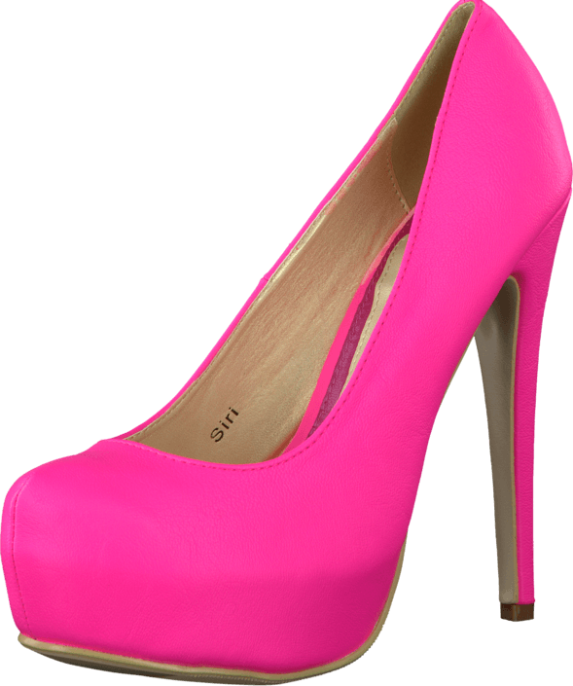
Woman Rights
History, achievements and current issues
Oleksandra Zbaranska
English
9.1

Slide 2


Woman Rights
History, achievements and current issues
Oleksandra Zbaranska
English
9.1

Slide 3

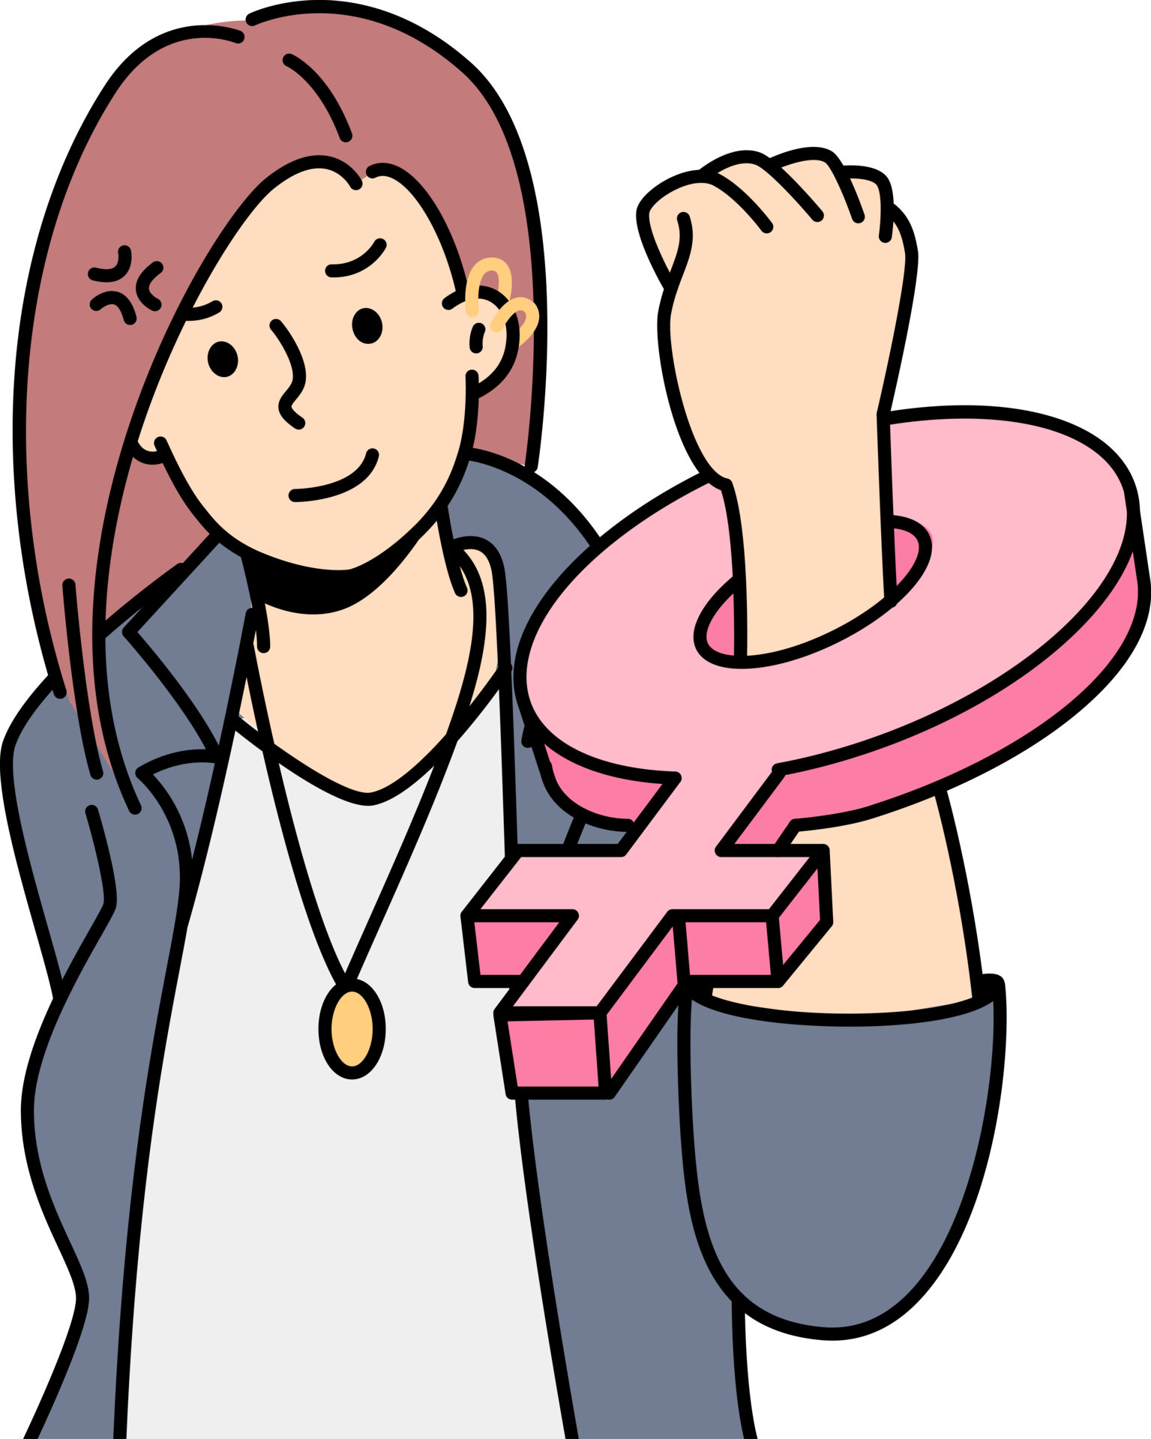
What are Women's Rights?
Women's rights are human rights specifically protecting the freedom and equality of women in society. These rights include access to education, employment, voting, and other essential aspects of life.
What is Feminism?
Feminism is a movement for equal rights and opportunities for women and men. It fights against discrimination and promotes gender equality in all areas of life.

Slide 4
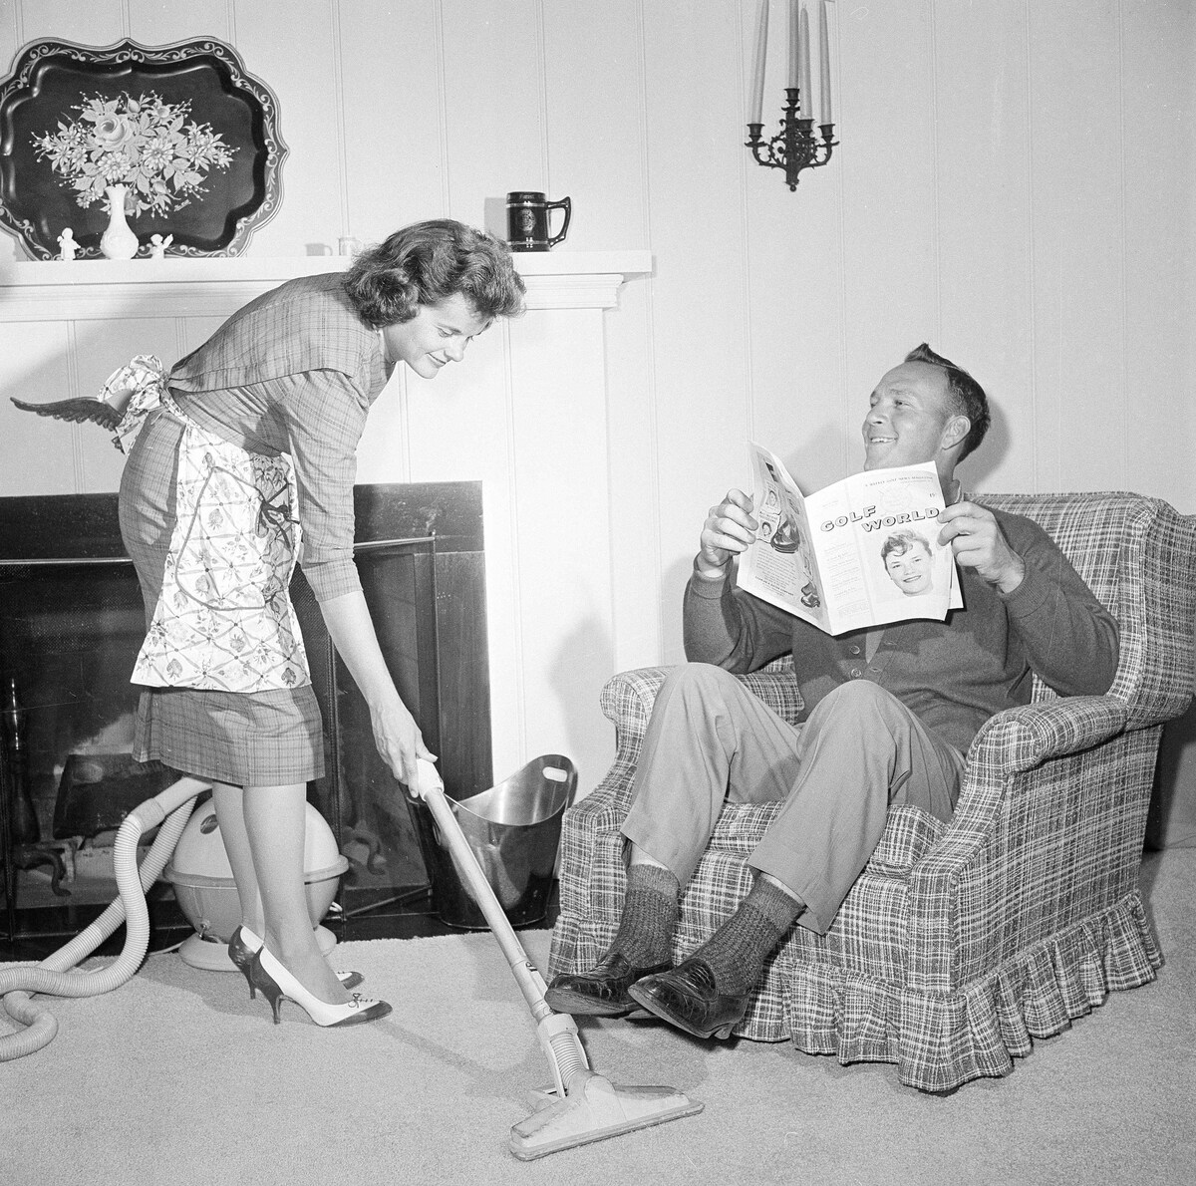
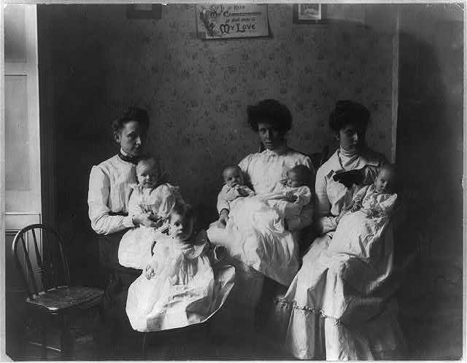
The role of women in society before:
Previously, women were not allowed to have a career and work, women's job was to keep house and raise children. Girls didn't even attend school/university because “Women didn't need an education”. And also women have always been the property of their husbands, they had no right to divorce them even if their husbands beat them..

Slide 5



Stereotypical woman in society :
the most popular stereotypes about women are that women only think about their appearance, they are weak physically and mentally, incapable of science and technology, women are only good for being homemakers and so on, as you might have guessed, these stereotypes really hinder women in life

Slide 6
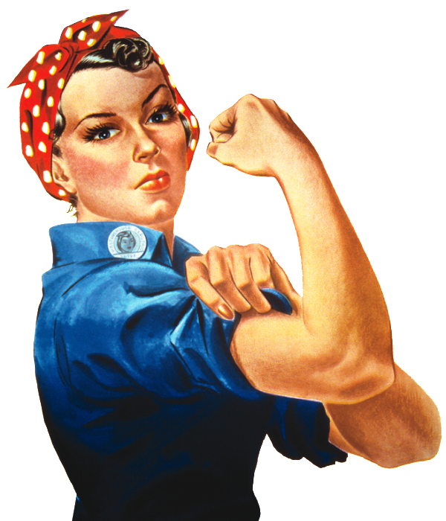
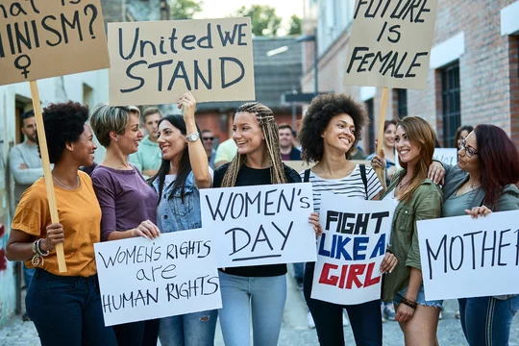
So to fight these stereotypes and for women's rights feminism was invented!

Slide 7
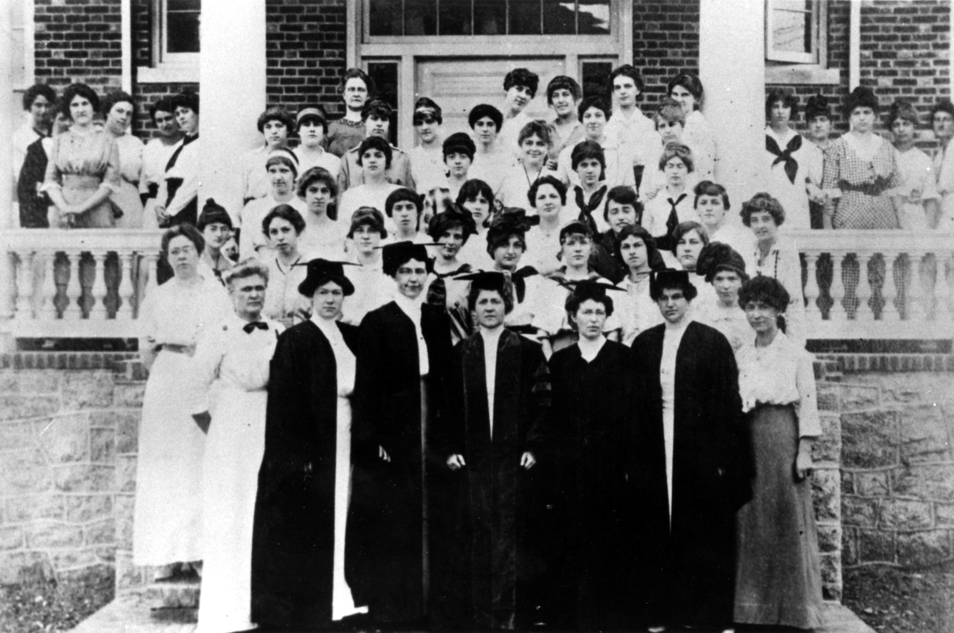
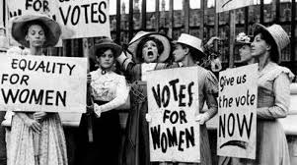
Historical Background #1:
18th Century: Mary Wollstonecraft publishes "A Vindication of the Rights of Woman" in 1792, arguing for women's education and equality.
19th Century: In 1836 women were allowed to enter university to study in America, in Germany in 1908. But despite this, women faced big problems there
19th Century: The Seneca Falls Convention in 1848 marks the beginning of the women's suffrage movement in the United States.

Slide 8
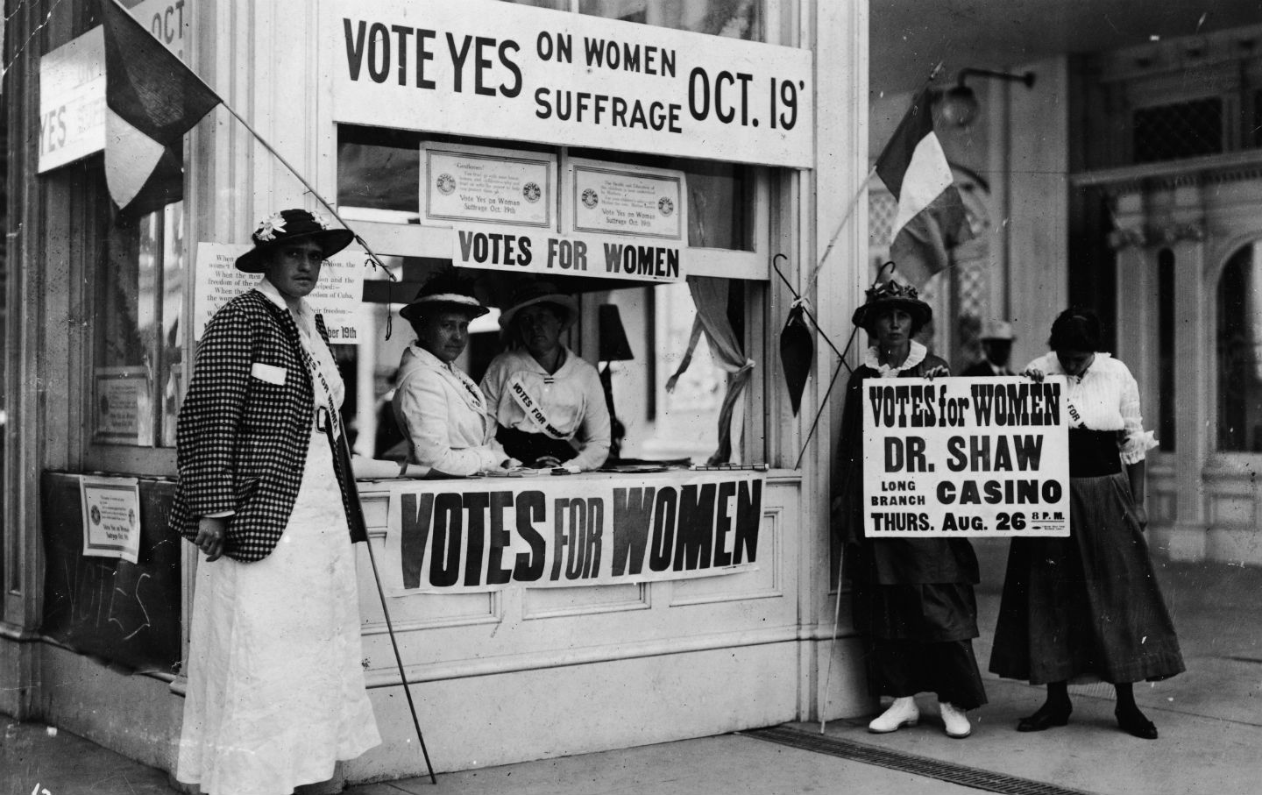

Historical Background #2:
1920: The 19th Amendment to the U.S. Constitution grants women the right to vote.
1966: Creation of NOW (National Organization of Women), the fight for legalization of abortions, lesbian rights, anti-discrimination, etc.
1973: The U.S. Supreme Court's Roe v. Wade case legalized abortion nationwide. In the GDR (East Germany), abortion became legal in the first 12 weeks in 1972, in the FRG (West Germany) in 1974

Slide 9

Some of you will say that "but that was before, now there is no discrimination against women, now almost everywhere there is equality of women and men, isn’t it?."
Yes, the situation has become much better thanks to feminists, however, there are still problems in international society which I will tell you about now

Slide 10

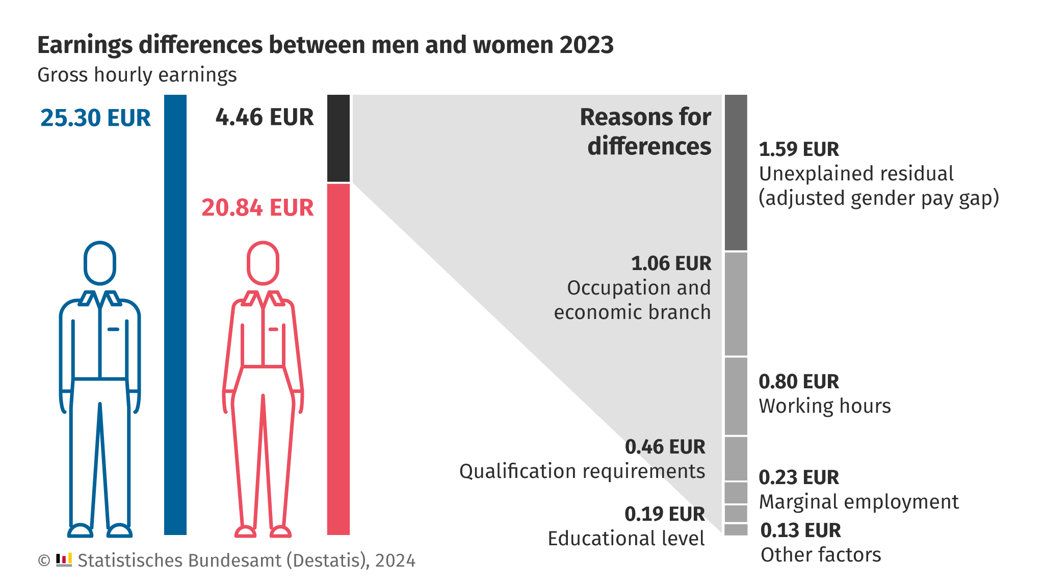
Problem #1: Career for women.
Although according to the law in many countries in our time women can make a career and work, unfortunately these stereotypes are still relevant for women. Women who try to make a career face many problems
Women’s payments are 18% smaller than men’s

Slide 11
Yes, the situation has become much better thanks to feminists, however, there are still problems in society which I will tell you about now

Slide 12

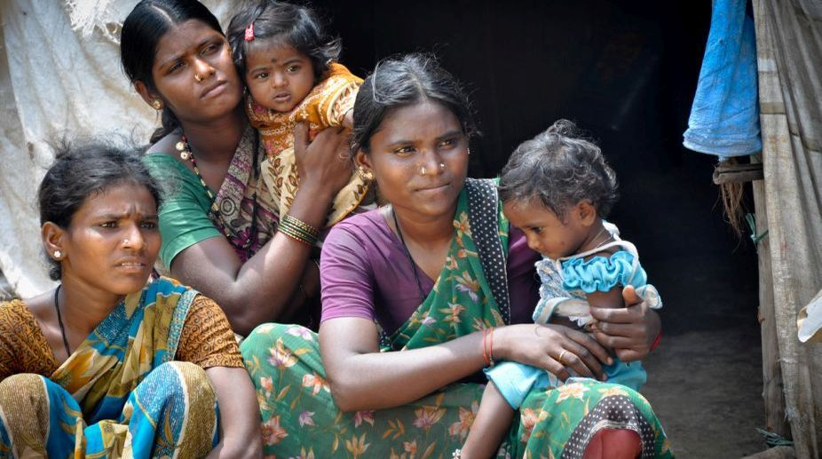
Problem #2 Children are only a woman's responsibility
Since ancient times children have been considered exclusively a woman's business, many still think so. In Muslim, African and Indian countries the main goal of a woman's life are children. When a child is born the woman usually has to leave her job even if she earns more than her husband. And if a woman doesn’t want to give up her career, then she has to work and raise a child at the same time.

Slide 13
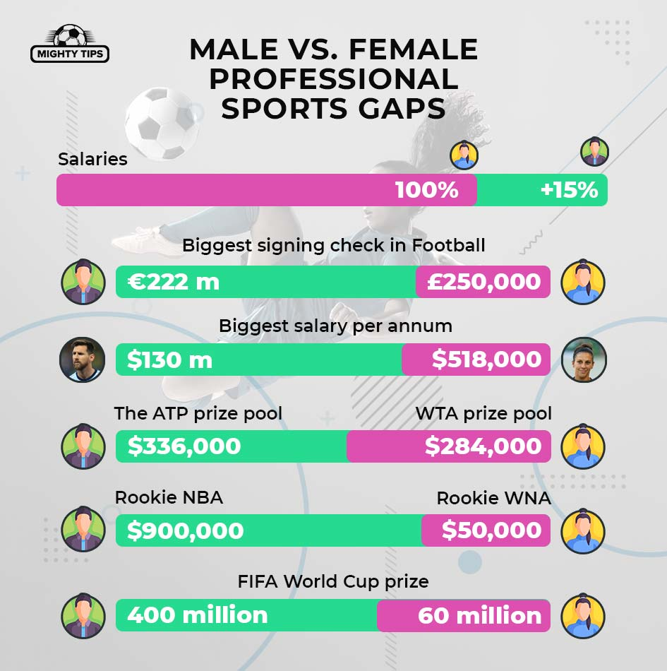
Problem #3.1: Women in Sport.
Unfortunately, sports are divided into "normal (for men)" and women's sports. If you look at the statistics, normal sports are much more popular than "women's sports", because of this, women athletes and women's sports agencies earn much less.

Slide 14
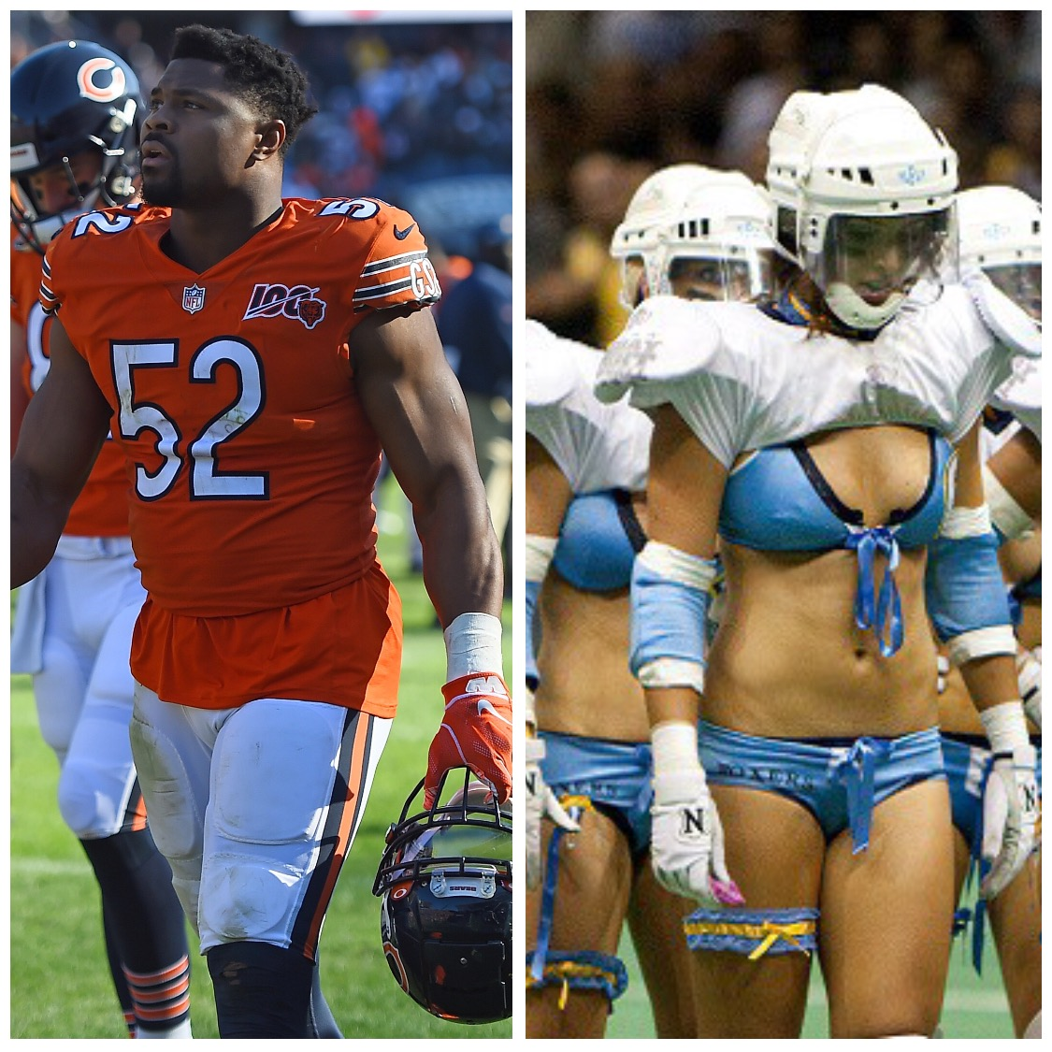
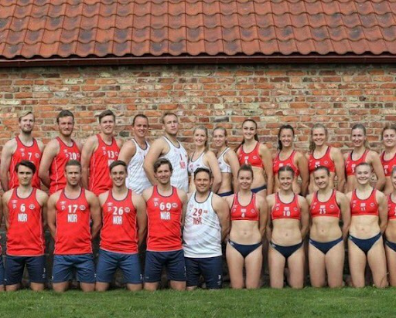
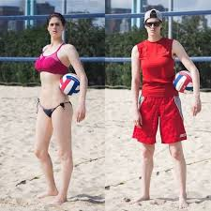
Problem #3.2: sexualization of women's uniforms in sports

Slide 15
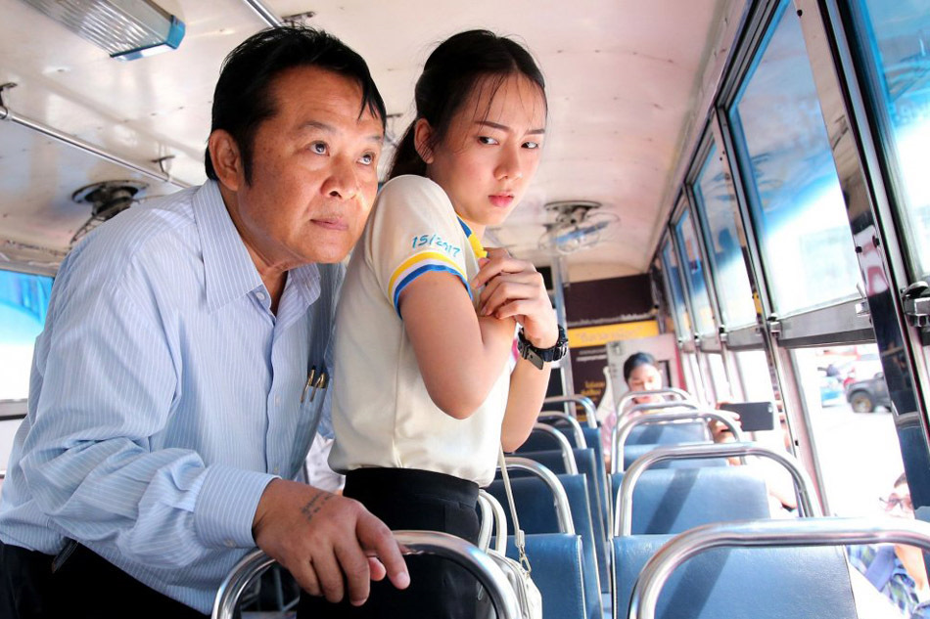

Problem #4.1: Sexual violence and harassment:
Sexual Violence: Many women experience sexual violence and harassment in both their personal and professional lives.
Lack of support: Often women do not receive the support and protection they need from the justice system.
Very often when a woman is raped, society blames the woman for it "You shouldn't have dressed like that“

Slide 16
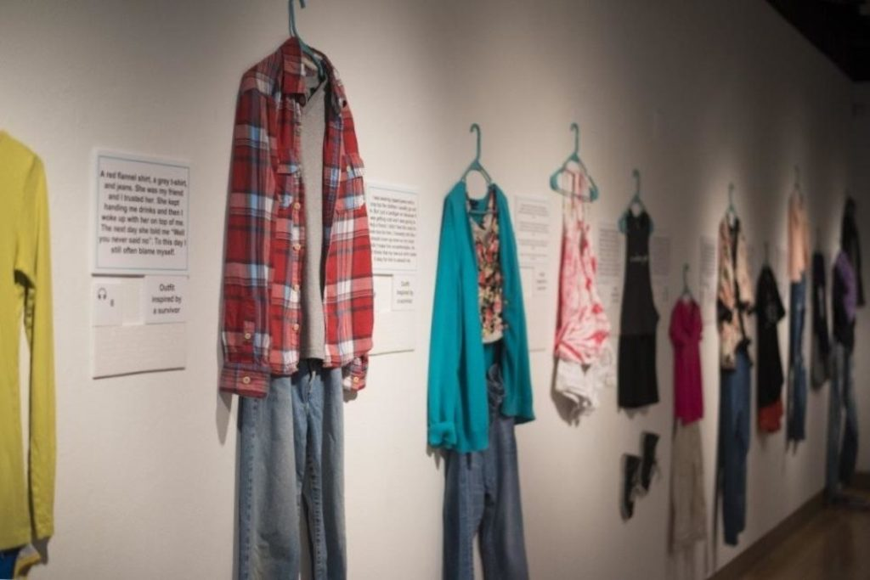
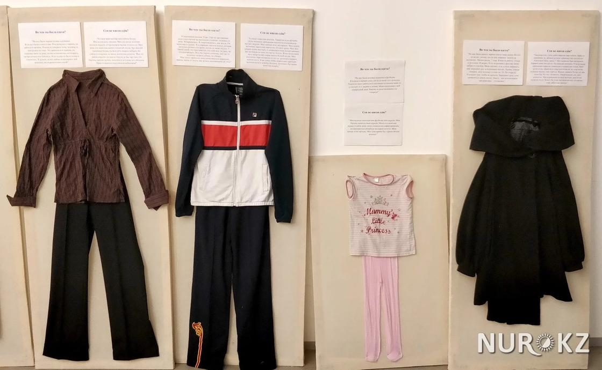
Problem #4.2: "You shouldn't have dressed like that“ :
Very often when a woman is raped, society blames the woman for it "You shouldn't have dressed like that“
However here are photos of the actual clothes that women wore when they were raped
Despite this fact and these photos being widespread, society still blames women for rape

Slide 17

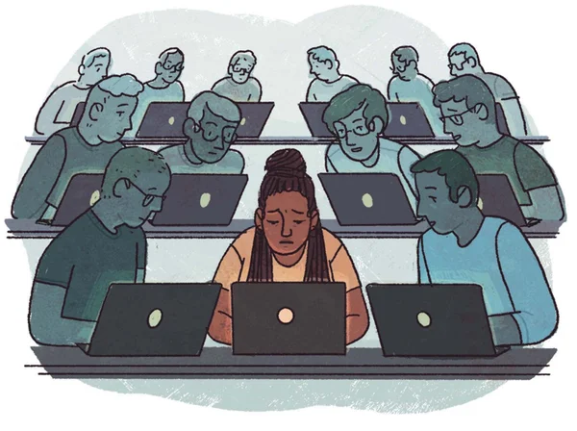
Problem #5: Education and professional development:
Girls and women in some parts of the world have limited access to quality education.
Stereotypes and bias against women in science, technology, engineering, and mathematics (STEM).
There are only 28% percent women in the IT industry in the world

Slide 18

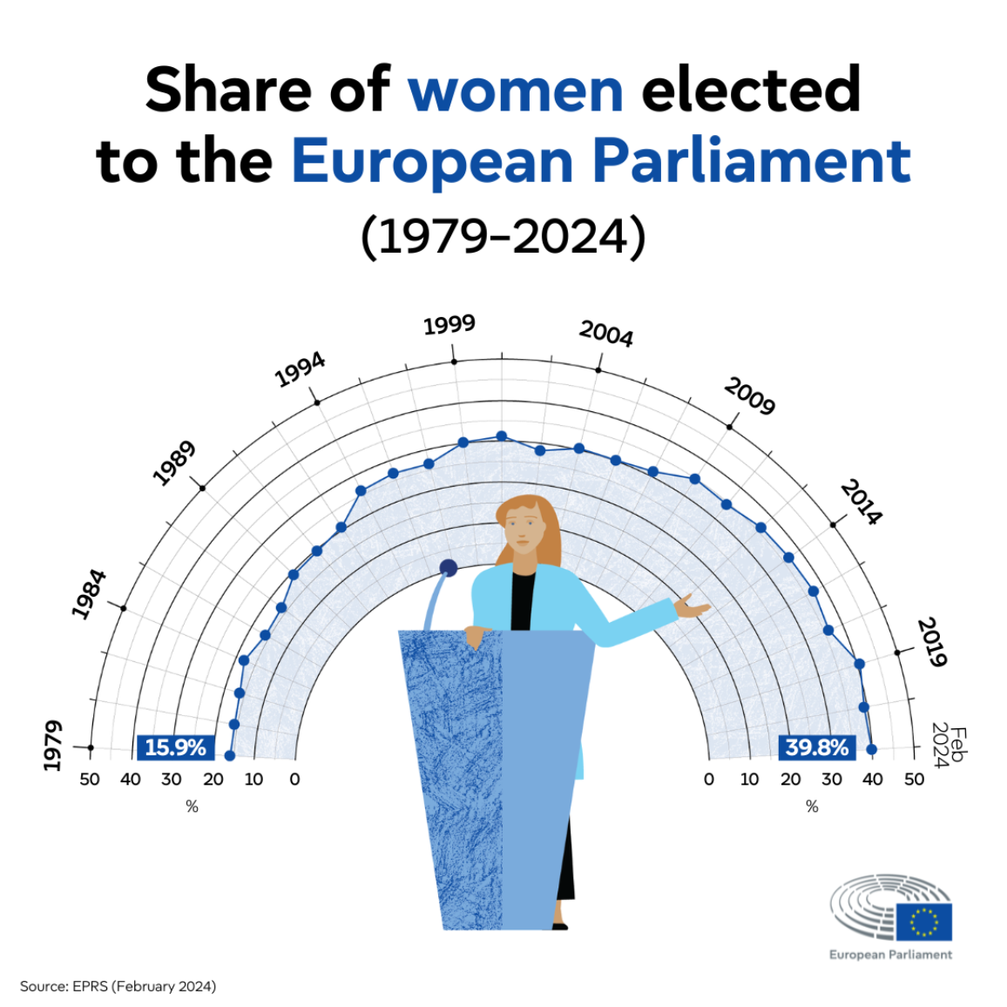
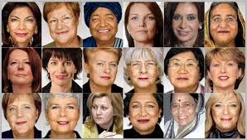
Problem #6: Political participation:
A lot of people think that politics is not a woman's occupation, because of this there are only about 26% percent of women in politics in the world and only 16 women are and were presidents.

Slide 19


Conclusion:
Overcoming these problems requires a comprehensive approach, including legislative initiatives, changing public opinion, educational programs and the active participation of both men and women in the fight for gender equality. Supporting and promoting women's rights play a key role in creating a fair and equal society.

Slide 20

Thank you for your attention
Oleksandra Zbaranska
English
9.1

